Slide 1
CNN Basics
Convolution
Source: https://medium.com/nybles/a-brief-guide-to-convolutional-neural-network-cnn-642f47e88ed4

Slide 2
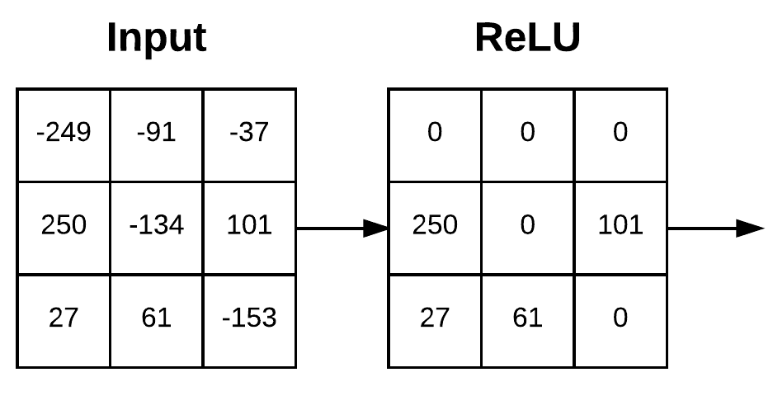
CNN Basics
Convolution + Activation
Source: https://pyimagesearch.com/2021/05/14/convolutional-neural-networks-cnns-and-layer-types/

Slide 3
CNN Basics
Pooling
Source: https://medium.com/nybles/a-brief-guide-to-convolutional-neural-network-cnn-642f47e88ed4

Slide 4
CNN Basics
Convolution – RGB Color Channels
Source: https://medium.com/nybles/a-brief-guide-to-convolutional-neural-network-cnn-642f47e88ed4

Slide 5
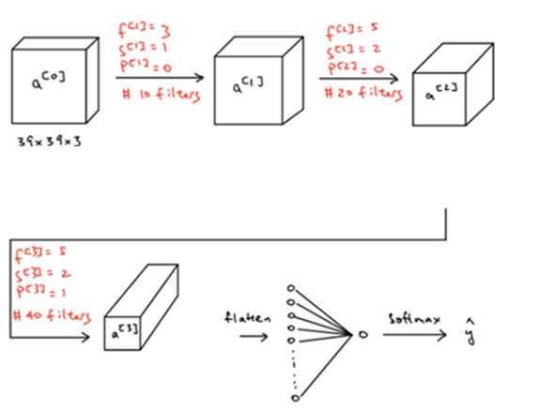


2-D Convolution
Source: https://guandi1995.github.io/Pooling-Layers/

Slide 6
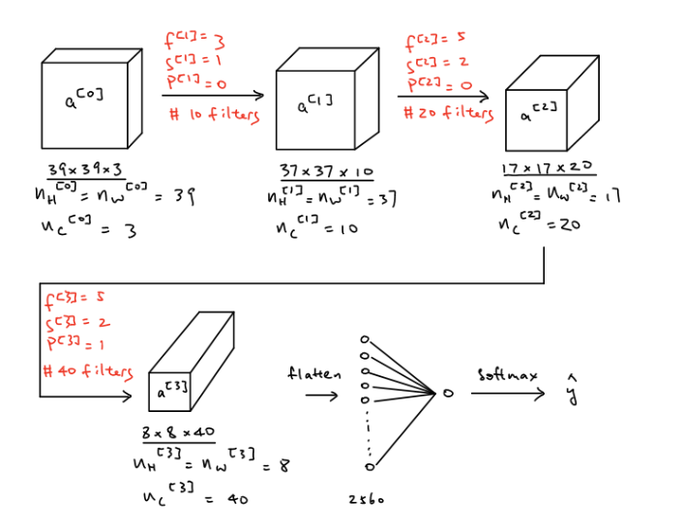
2-D Convolution
Source: https://guandi1995.github.io/Pooling-Layers/

